Slide 1
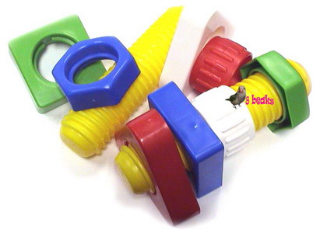
Threaded Fasteners
Chapter 11

Slide 2
TOPICS
Introduction
Thread terminology
Thread drawing and dimensioning
Threaded fastener

Slide 3
Introduction

Slide 4
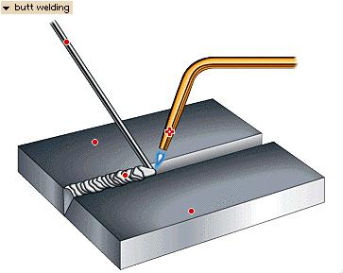
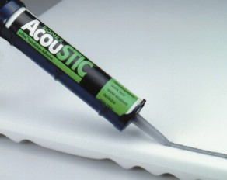
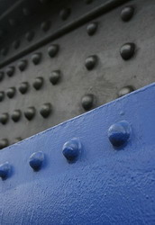
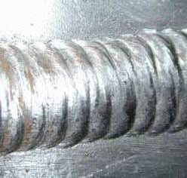
FASTENING TYPE
1. Permanent
Welding
Gluing
Riveting

Slide 5
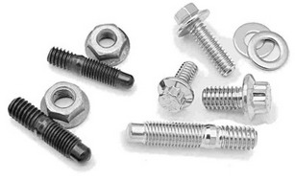
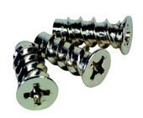
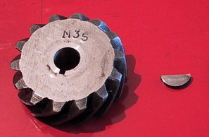
FASTENING TYPE
2. Temporary
2.1 Threaded fastener
- bolts
- studs
- screws
2.2 Non-threaded fastener
- keys
- pin
key

Slide 6
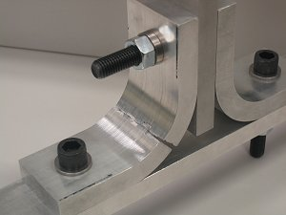
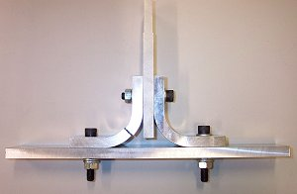
THREAD APPLICATION
1. To hold parts together.
2. To move part(s) relative to others.
Part A
Part B
Part C

Slide 7
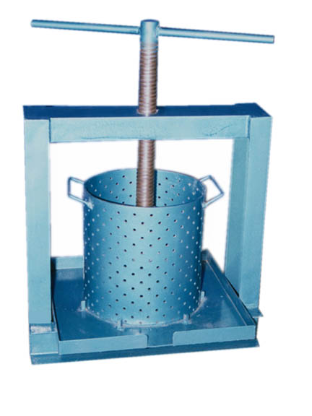
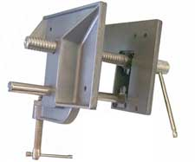
THREAD APPLICATION
1. To hold parts together.
2. To move part(s) relative to others.
Wood working vise
Palm fruit pressing machine

Slide 8
Thread Terminology

Slide 9
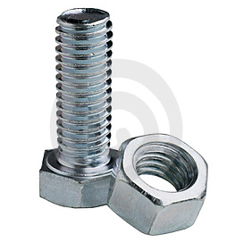
THREAD TERMINOLOGY
External (male)
thread
A thread cut on the outside of
a cylindrical body.
Internal (female)
thread
A thread cut on the inside of
a cylindrical body.
External thread
Internal thread

Slide 10
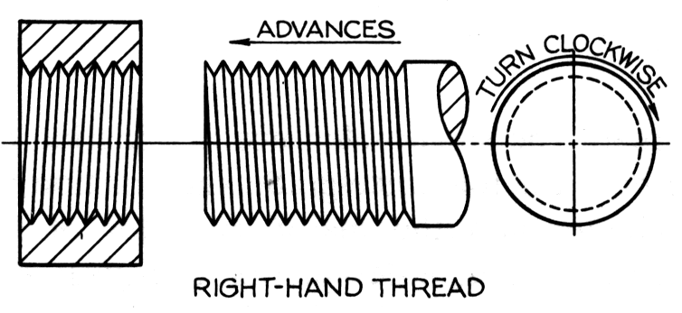
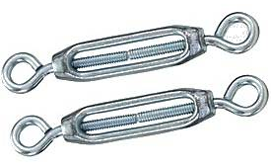
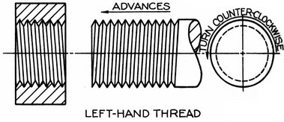
THREAD TERMINOLOGY
Right-hand
thread
Thread that will assemble when
turned clockwise.
Left-hand
thread
Thread that will assemble when
turned counter-clockwise.
Turnbuckle use RH and LH thread at each end to double displacement.

Slide 11
THREAD TERMINOLOGY
Crest
The peak edge of a thread.
Root
The bottom of the thread cut into
a cylindrical body.
Thread angle
The angle between threads faces.
External Thread
Internal Thread
Thread angle
Root
Crest
Root
Crest

Slide 12
THREAD TERMINOLOGY
The largest diameter on
an internal or external thread.
Major diameter
The smallest diameter on
an internal or external thread.
Minor diameter
External Thread
Internal Thread
Minor dia.
Major dia.
Minor dia.
Major dia.

Slide 13
THREAD TERMINOLOGY
The distance between crests of
threads.
Pitch
The distance a screw will advance when turned 360º.
Lead
External Thread
Internal Thread
Pitch
Pitch

Slide 14
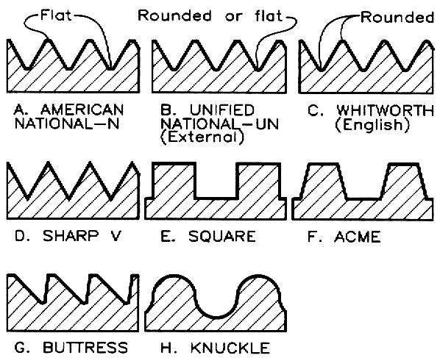
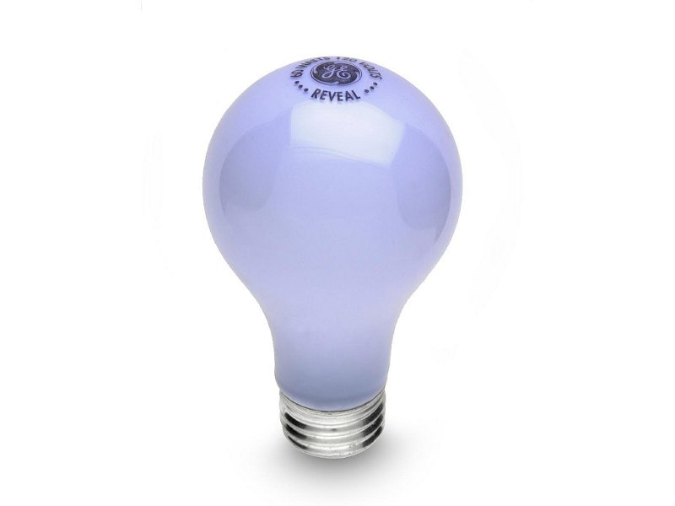
THREAD TERMINOLOGY
Thread Form
Form is the profile shape of the
thread.
Example :
“knuckle thread form”

Slide 15
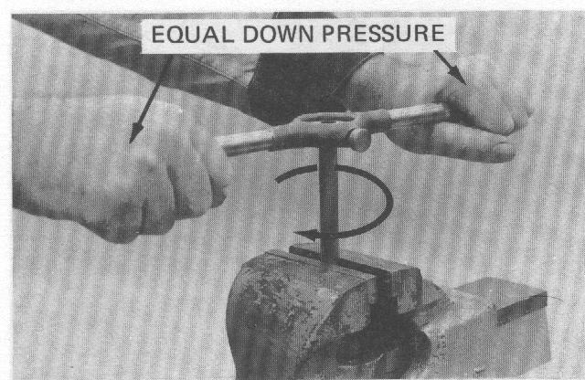
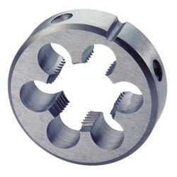

EXTERNAL THREAD CUTTING
Tools
Operation
Threading Die
Die stock

Slide 16
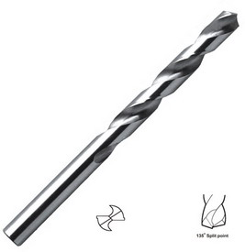
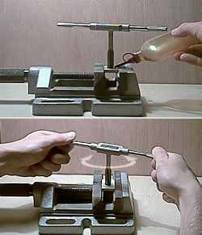
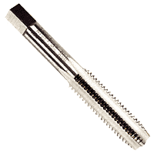
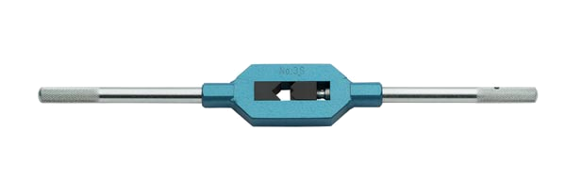
INTERNAL THREAD CUTTING
Tools
Operation
Twist drill
Tap
Tap wrench

Slide 17
COMPARISON OF THREAD CUTTING
External Thread
Internal Thread
Minor Dia.
Major Dia.

Slide 18
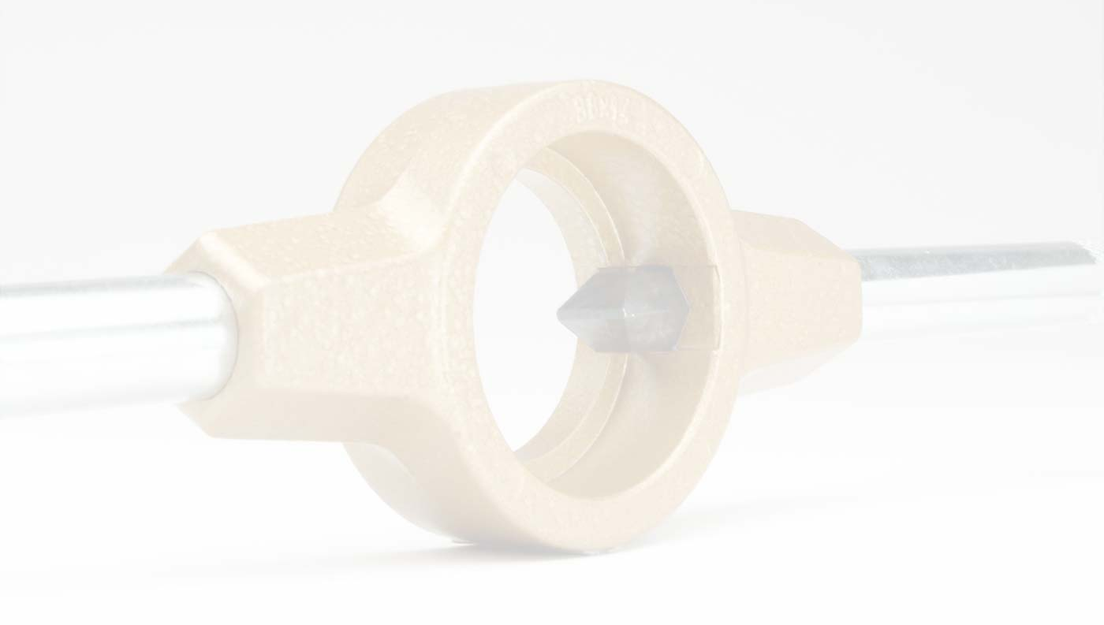
Thread Drawing

Slide 19
THREAD REPRESENTATION
1. Detailed representation
2. Schematic representation
3. Simplified representation

Slide 20
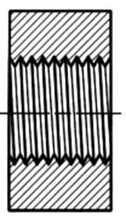
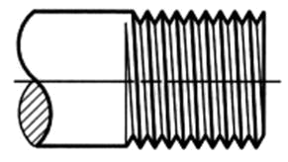
DETAILED REPRESENTATION
Use slanting lines to represent crest and root.
Roots and crest are drawn in sharp Vs.
External thread
Internal thread
Thread runout
Pitch
60º

Slide 21
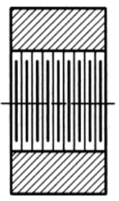
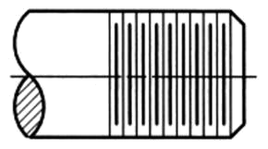
SCHEMATIC REPRESENTATION
Use alternate long and short lines for representing
crests and roots of the thread, respectively.
External thread
Internal thread
Root (thick line)
Pitch
Crest (thin line)

Slide 22
SIMPLIFIED REPRESENTATION
Use thick continuous lines for representing crest
and thin continuous lines for representing root of
the thread, respectively.
External thread
Internal thread
Thread runout
Pitch/2
Root
Crest

Slide 23
SIMPLIFIED REPRESENTATION
Use thick continuous lines for representing crest
and thin continuous lines for representing root of
the thread, respectively.
External thread
Internal thread
Sectional view

Slide 24
ISO (METRIC) THREAD
P/8
Internal
thread
60º
P/4
External
thread
Pitch, P
Center of thread assembly
Thread assemble occurs if and only if both (internal & external)
thread have an equal nominal size (or diameter) and pitch.

Slide 25
METRIC COARSE THREAD
[Table 9.1]
Nominal size | Major diameter | Pitch | Minor diameter | Tap drill size
M6 | 6.00 | 1.00 | 4.92 | 5.00
M8 | 8.00 | 1.25 | 6.65 | 6.75
M10 | 10.00 | 1.50 | 8.38 | 8.50
M12 | 12.00 | 1.75 | 10.11 | 10.00
Metric thread
Minor diameter ≈ Tap drill size
In thread drawing, the following relationship is used.
Minor diameter = Major diameter – Pitch

Slide 26
METRIC FINE THREAD
[Table 9.2]
Nominal size | Major diameter | Pitch | Minor diameter | Tap drill size
M8 | 8.00 | 0.75 | 7.188 | 7.25
 |  | 1.00 | 6.917 | 7.00
M10 | 10.00 | 0.75 | 9.188 | 9.25
 |  | 1.00 | 8.917 | 9.00
 |  | 1.25 | 8.647 | 8.75
Minor diameter ≈ Tap drill size
In thread drawing, the following relationship is used.
Minor diameter = Major diameter – Pitch

Slide 27
DRAWING STEPS OF
EXTERNAL THREAD
Draw an arc that
represents a root.
Draw a circle that
represents a crest.
Draw
45º Chamfer
Draw line making
30º with thread axis
Draw
thread
axis
Major dia.
Minor dia.
Thread Length
Starting
position

Slide 28
DRAWING STEPS OF
THREADED HOLE
Internal Thread
1. Through threaded hole
Sectional view
Draw a crest
Draw a root
root
crest
Draw
thread
axis
Major dia.
Minor dia.
Draw a circle that
represents a crest.
Section lines are drawn into the crest of a thread.
Draw an arc that
represents a root.

Slide 29
DRAWING STEPS OF
THREADED HOLE
2. Blinded threaded hole
Draw
thread
axis
Major dia.
Minor dia.
Draw a circle that
represents a crest.
Thread depth
Draw an arc that
represents a root.
Hole depth

Slide 30
DRAWING STEPS OF
THREADED HOLE
2. Blinded threaded hole
Sectional view

Slide 31
DIMENSIONING EXTERNAL THREAD
Use local note to specify :- thread form, nominal size, pitch (if it is a fine thread)
Use typical method to specify :- thread length.
M
10
×1.5
Coarse thread
×1.0
Fine thread
Thread
length
xx

Slide 32
DIMENSIONING THREADED HOLE
Use local note to
specify
8.50 Drill, 20 Deep,
M10 Tapped, 15 Deep
1. Tap drill size
2. Drill depth
3. Thread form
4. Nominal size
5. Pitch
6. Thread depth

Slide 33
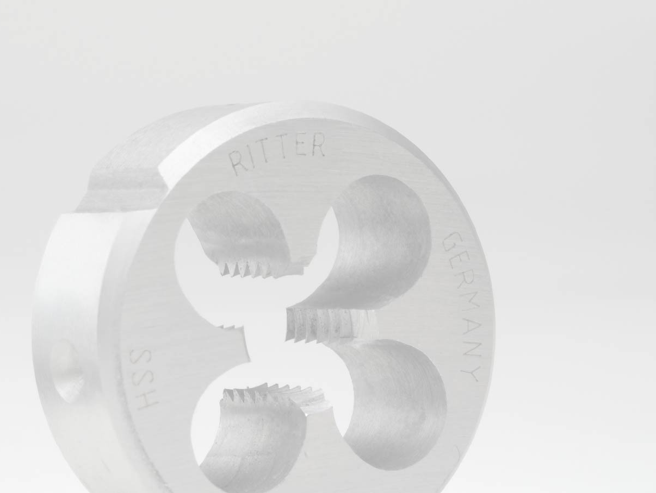
Threaded Fastener

Slide 34
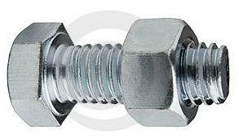
BOLT : Terminology
Bolt is a threaded cylinder with a head.
Thread length
Hexagonal head
bolt and nut
Length
Width across flat
Head
thickness
Dimensions of bolt’s head are
listed in table 9.4.

Slide 35
BOLT : Drawing steps
Draw an
end view
of the head
Draw a
bolt head
Draw
body of a bolt
30º
Draw
bolt
axis
Major φ
B/2
B/2
H
Length
B
Thread Length
Starting
position

Slide 36
NUT : Drawing steps
Dimensions of the nut are given in Table 9.14.
Draw an end view
of the nut
B/2
B/2
H
B
Dash lines represent
a threaded hole are
omitted for clarity.

Slide 37
BOLT : Application
2. Insert a washer.
3. Screw a nut.
1. Insert a bolt into
a clearance hole

Slide 38
Let’ s think together…
What do you think about the following suggestions for
design improvement?
(A) Nothing have to be changed.
(B) Use shorter bolt with the
same thread length.
(C) Reduce the thread length.
(D) Add washer or nut.
Correct
Inappropriate
Wrong

Slide 39
Let’ s think together…
What do you think about the following suggestions for
design improvement?
(A) Nothing have to be changed.
(B) Use a bolt of this length but
has a longer thread length.
(C) Use a longer bolt with the
same thread length.
(D) Add washer.
Correct
Inappropriate
Wrong

Slide 40
Let’ s think together…
What do you think about the following suggestions for
design improvement ?
(A) Nothing have to be changed.
(B) Use a bolt of this length but
has a shorter thread length.
(C) Use a longer bolt with the
same thread length.
(D) Add washer.
Correct
Inappropriate
Wrong

Slide 41
Let’ s think together…
What do you think about the following suggestions for
design improvement?
(A) Use a bolt of this length but
has a shorter thread length.
(B) Use a longer bolt with the
same thread length.
(C) Use a longer bolt by
increasing a thread length
(D) Remove washer.
Correct
Inappropriate
Wrong

Slide 42
Let’ s think together…
What do you think about the following suggestions for
design improvement ?
(A) Increase the bolt diameter.
(B) Use washer with larger
outside diameter.
(C) Reduce the hole diameter.
(D) Add washer at bolt head.
Correct
Inappropriate
Wrong

Slide 43
Let’ s think together…
What do you think about the following suggestions for
design improvement ?
(A) Nothing have to be changed.
(B) Use a bolt with shorter
thread length.
(C) Add washer.
(D) Increase drill and thread
depths.
Correct
Inappropriate
Wrong

Slide 44
Let’ s think together…
What do you think about the following suggestions for
design improvement ?
(A) Nothing have to be changed.
(B) Use a bolt with slightly
longer thread length.
Correct
Inappropriate
Wrong

Slide 45
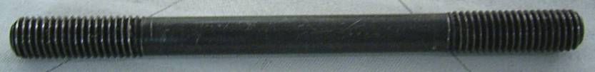
STUD : Terminology
Stud is a headless bolt, threaded at both ends.
Thread length
Thread length
Drawing
representation
Length

Slide 46
STUD : Drawing steps
Draw
45º Chamfer
Draw line making
30º with axis
Draw
45º Chamfer
Draw
stud
axis
Minor φ
Major φ
Thread Length
Thread Length
Stud Length
Starting
position

Slide 47
STUD : Application
1. Drill a hole.
2. Tap a hole.
3. Screw a stud.
4. Place the part to be
fastened.
5. Insert washer and
fastened a nut.

Slide 48
Let’ s think together…
What is the mistake in the following use of stud ?

Slide 49
Let’ s think together…
What is the mistake in the following use of stud ?

Slide 50
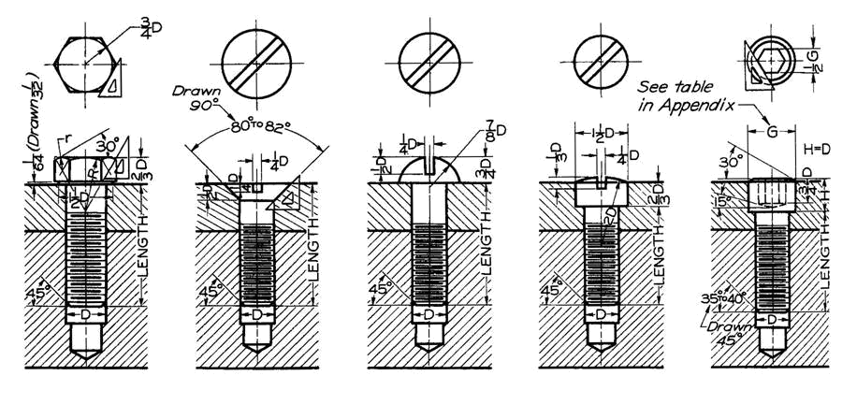
CAP SCREW : Terminology
Cap screw is similar to bolt, but has a longer thread than a bolt.

Slide 51
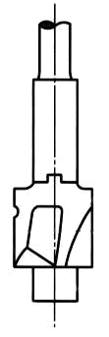
CAP SCREW : Counterbore hole
x drill,
φ y C’bore,
z deep
x drill,w deep,
φ y C’bore,
z deep
z

Slide 52
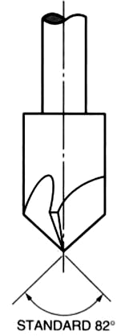
CAP SCREW : Countersink hole
x drill,
CSK to φy
x drill, w deep,
CSK to φy
Draw 90º
y

Slide 53
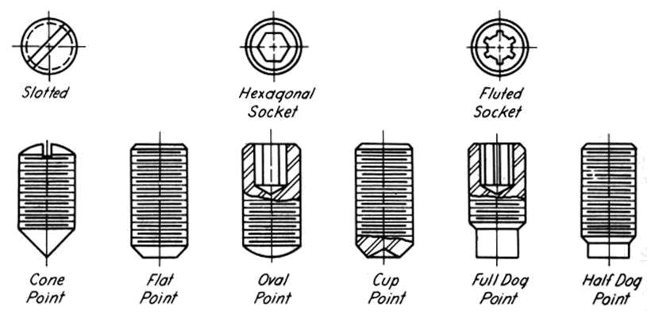
SET SCREW : Terminology
Set screw is a threaded cylinder used to prevent rotation or movement between parts.

Slide 54
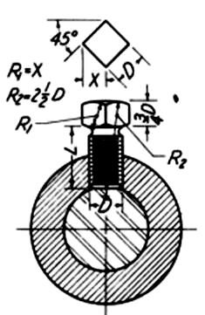
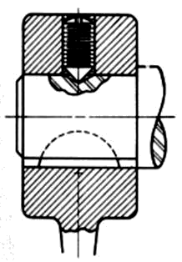
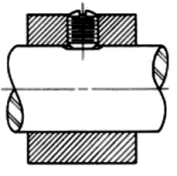
SET SCREW : Application

